Slide 1
The Book Thief and the Time Thief
Steve Henry

Slide 2

Leisel Meminger
Books and story as an antidote
Liesel steals a book from the Nazi fires, she needs books to:
Tell right from wrong
Give hope to people in bomb shelters
Learn about her world – its tragic nature, its pain, its beauty
Understand herself and people
Create a shared narrative of friendship
Grow

Slide 3

24 (according to the Digital Me survey in 2017)
The Time Thief
How many hours does an average teenager spend on social media in an average week?

Slide 4
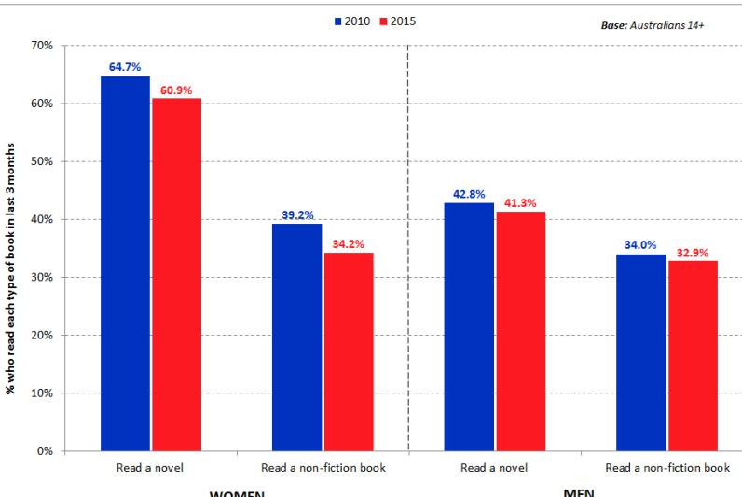
Our Challenge
To prepare students for an HSC (and for an adult world) that requires a slightly different set of skills.
Graphic: Roy Morgan: Reading habits 2010-2015

Slide 5

The skills of English
Reading
Representing (Writing and Speaking)
Listening/Viewing

Slide 6
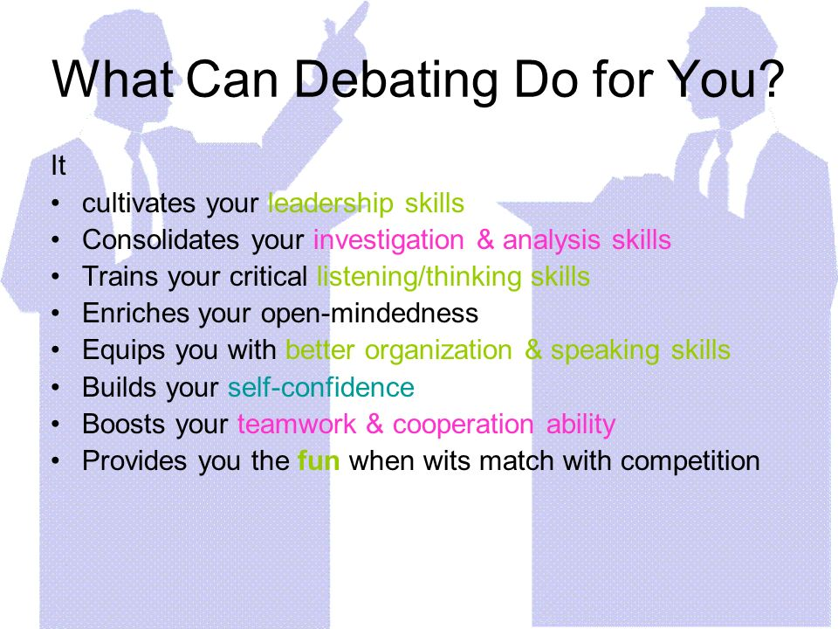
Speaking
Debating vs Emotional responses and Youtube comments
Face to face vs keyboard and screen

Slide 7
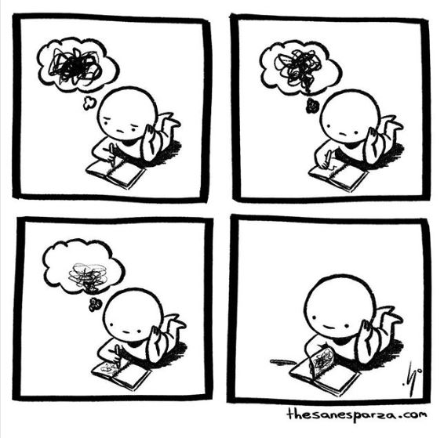
Writing
Carefully structured argument vs Sensationalised biased reporting
Crafted creatives vs meme humour and tiktok stories

Slide 8

Reading
Fiction vs non-fiction
Novels vs short form
Exploring diverse worlds and perspectives vs the self-referential algorithm

Slide 9
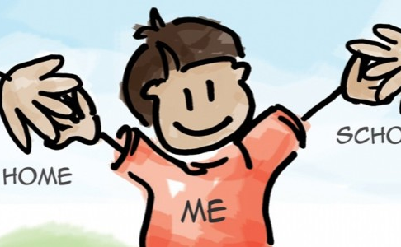
Taking time to prepare students, old skills new focuses
New focuses:
discursive writing
the craft of writing
personal voice in essays
the idea of culture embedded in language
In order for students to rise to the requirements of the HSC and society, we need to take back some time to develop their skills and knowledge, in class, out of class . . .

