Slide 1
Lifesaving 2024
SWIM AND SURVIVE PROGRAM

Slide 2
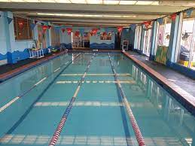
SWIM SCHOOL - WHAT IS IT?
In weeks 2 and 3, Term 4, 2024, all Year 8 students will be involved in the compulsory Lifesaving Program. There are 5 courses from which you can choose. All courses include a first aid theory component, resuscitation training and practical assessment.
Courses will run at 2 different pools. You cannot select which pool you are at, and choosing the same course as a friend does not mean you will be together. There are approximately 15 students in a group, with 2 Year 9/10 student instructors

Slide 3
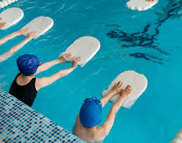
Course 1 - WATER AWARENESS
This course is designed for non-swimmers. It aims to increase your confidence in the water, water safety, swimming and survival abilities. Some skills you will aim to master include:
Front and back float
Blow bubbles in water with face submerged
Front glide and back kick using a kickboard
Swim for 3m using an underwater arm action
Swim 5m freestyle and 5m backstroke with modifications
Hold floatation aids and be pulled to safety

Slide 4
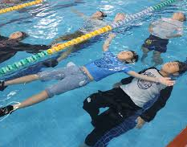
Course 2 - Water Sense
This course aims to provide the learner with confidence in safety and survival abilities, including basic techniques of clothed survival swimming, and to extend the basic swimming skills and personal fitness for survival. This is suitable for poor swimmers.
Assessment includes:
a written test
25m continuous swim using basic stroke techniques
survival and rescue components.

Slide 5
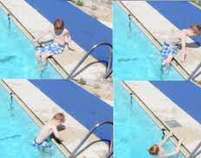
Water sense - skills
Slide in entry in deep water
Front and back float in deep water
25m swim freestyle and backstroke with correct stroke
10m breaststroke with correct kick
Survival scull/tread water for 1 min.
Surface dive in chest deep water to recover an object.
Rescue techniques

Slide 6
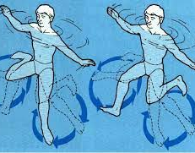
Course 3 - Junior swim and survive
This course aims to provide the learner with safety and survival abilities, including basic techniques of clothed survival swimming, and to extend the range of swimming skills and personal fitness for survival.
Assessment includes:
a written test
100m continuous swim using correct and efficient stroke techniques of freestyle, backstroke and breaststroke
survival and rescue components
Tread water for 4 minutes (clothed) then swim for 6 minutes whilst removing clothing
This is suitable for average swimmers.

Slide 7
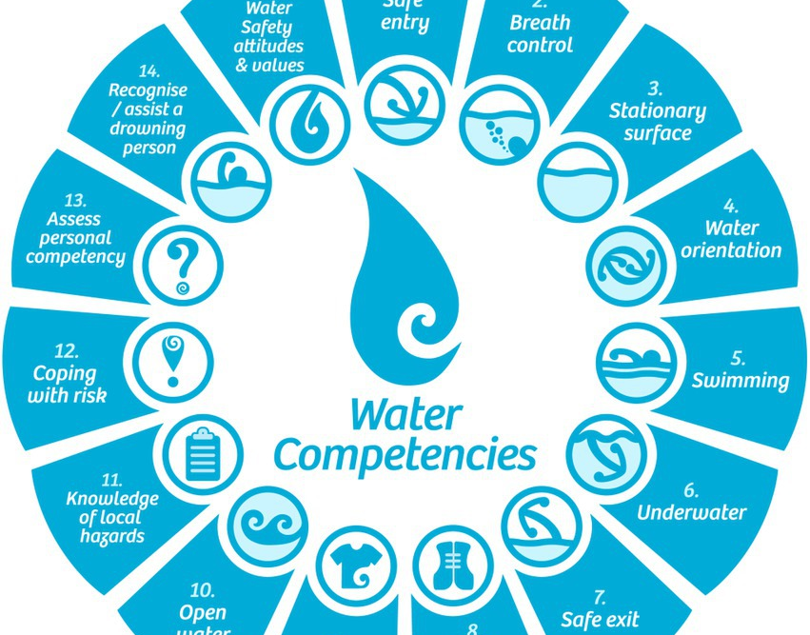
Course 4 - Senior swim and survive
This course aims to develop a high level of swimming skills, endurance, knowledge of safety and personal survival abilities.
Assessment includes:
a written test
300m continuous swim using correct and efficient stroke techniques
a variety of pool entries and dives, eggbeater kicks, clothed swim
survival and rescue components.
This suitable for average to above average swimmers.

Slide 8
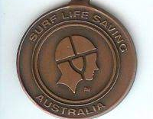
Course 5 - Bronze medallion
This is the highest lifesaving award offered; all students must be 14 to achieve this award. The course aims to develop a level of knowledge, judgement, technique and physical ability required to carry out safe water rescue.
Assessment includes
a written test
400m continuous swim using correct and efficient stroke techniques
6 different rescue techniques (including defensive techniques and spinal rescue)
search and rescue,
a timed tow
survival and rescue components.
This is suitable for advanced swimmers only.

Slide 9
Please discuss these options with your parents to ensure you select the course that best suits your needs and abilities. If you have any further questions please speak to your PE Teacher, Mrs Flowers, Miss Zappala or Miss Berios

