Slide 1
Stage 5 Subject Selection 2023 - 2024
Cherrybrook Technology High School
Presented by Mr. Gary Monahan
Head Teacher – Stage 5

Slide 2
Acknowledgement to Country

Slide 3
NSW Education Standards Authority (NESA) Requirements

Slide 4
Record of School Achievement (RoSA)
All students that successfully complete Year 10 but do not go on and complete their HSC will receive a RoSA.
A RoSA provides an ongoing, cumulative record of student achievement.
The grades for courses completed in all of Stage 5 (Year 9 and 10) will contribute to the grade given at the end of Year 10.
Grades are allocated according to NESA Course Performance Descriptors.
RoSA’s can potentially be used for early entry to university and for scholarship applications.
More information can be found at: https://educationstandards.nsw.edu.au/wps/portal/nesa/11-12/leaving-school/record-of-school-achievement

Slide 5
HSC Literacy and Numeracy Minimum Standards Testing
During Year 10, 11 and 12 students will be given the opportunity to complete the 3 minimum standards tests:
Reading
Writing
Numeracy
The minimum standard is nationally agreed and mapped to Level 3 of the Australian Core Skills Framework.
National Assessment Program – Literacy and Numeracy (NAPLAN) is no longer used as a minimum standards test and will be used as per its original purpose as a diagnostic tool to track students progress and identify students that require additional assistance.
More information can be found at: https://educationstandards.nsw.edu.au/wps/portal/nesa/11-12/hsc/hsc-minimum-standard

Slide 6
Cherrybrook Technology High School - Stage 5 Requirements

Slide 7
Stage 5 (Year 9 & 10) Subjects
By the end of Year 10 students will have completed:
English – 200 hours
Mathematics – 200 hours
Science – 200 hours
PDHPE/Sport – 200 hours
Geography – 100 hours
History – 100 hours
Vocational Education – 50 hours
Elective Courses Units – 700 hours (14 semester courses)

Slide 8
Year 9 Subjects:
English (all year)
Mathematics (all year)
Science (all year)
PDHPE (all year)
History (one semester)
Geography (one semester)
8 elective course units

Slide 9
Semester 1
English
Elective 2
Semester 2
English
Maths
Elective 6
Science
PDHPE
History
Elective 5
Elective 1
Maths
Science
PDHPE
Geography
Elective 3
Elective 4
Elective 7
Elective 8

Slide 10
Year 10 Subjects
English (all year)
Mathematics (all year)
Science – Core A (all year)
PDHPE (all year)
History (one semester)
Geography (one semester)
Science – Core B (one semester)
Vocational Education (one semester)
6 elective course units

Slide 11
Semester 1
English
Elective 9
Semester 2
English
Maths
Elective 12
Science Core A
PDHPE
History
Science Core B
Vocational Ed
Maths
Science Core A
PDHPE
Geography
Elective 10
Elective 11
Elective 13
Elective 14

Slide 12
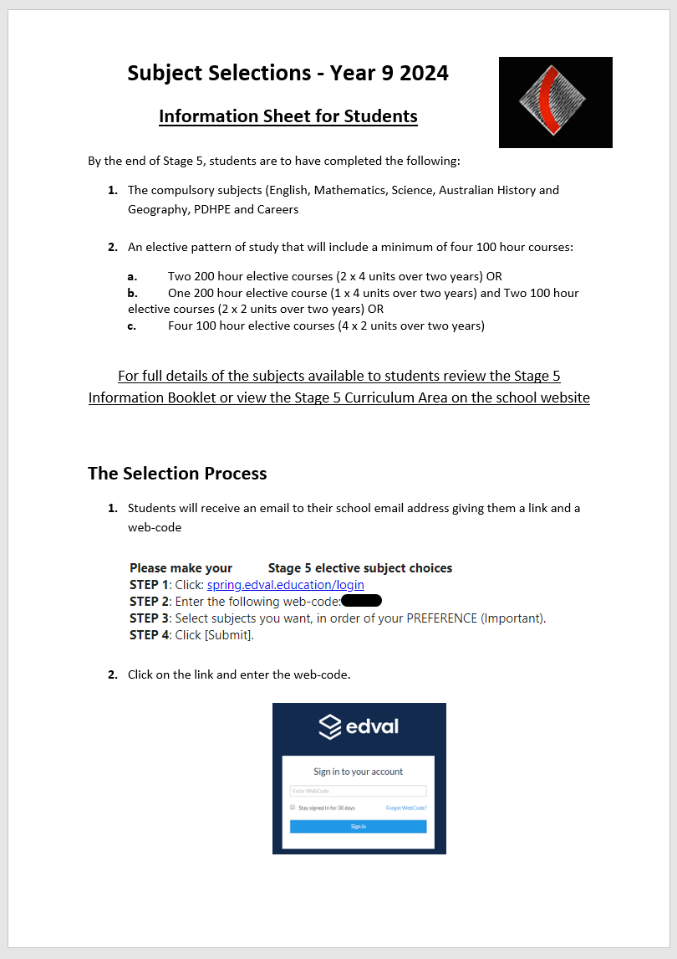
Choosing Subjects

Slide 13
Elective Subjects
Elective subjects are broken down into sections.
For example:
Key Learning Areas:
Curriculum Courses:
Dance
Drama
Music
Visual Arts
Photography

Slide 14
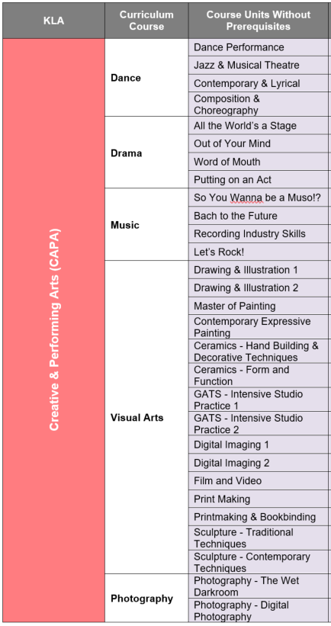
Course Units run for one semester and are equal to 50 hours of study.

Slide 15
You need to achieve a minimum of 400 hours of Elective – Curriculum Courses by the end of Year 10.
This can be achieved by:
2 x 200 hour courses
1 x 200 hour course and 2 x 100 hour courses
4 x 100 hour courses
Students receive a grade (A – E) for the following subjects:
English
Mathematics
Science
PDHPE
History
Geography
Any Elective - Curriculum Course that students obtain 100 hours (2 Course Units) or 200 hours (4 Course Units) over Year 9 and 10 combined.

Slide 16
An Example
A student wishes to study the following Curriculum Courses across Stage 5
200 hours of Industrial Technology – Timber
100 hours of Japanese
100 hours of Physical Activity and Sports Studies

Slide 17
They would choose the following Course Units:
Industrial Technology – Timber
Core 1 - General Wood (TW1)
Core 2 - General Wood (TW2)
Unit 3 - Cabinet Work – Specialised (TW3)
Unit 4 - Cabinet Work – Specialised (TW4)
Japanese
Japanese Level 3 (LJ3)
Japanese Level 4 (LJ4)
Physical Activity and Sports Studies
Sports Coaching (PSC)
Sports Fitness (PSF)

Slide 18
Year 9 Subjects
Semester 1
English
Japanese Level 3
Semester 2
English
Maths
Japanese Level 4
Science
PDHPE
History
General Wood 2
General Wood 1
Maths
Science
PDHPE
Geography
Elective 3
Elective 4
Sports Fitness
Elective 8

Slide 19
Year 10 Subjects
Semester 1
English
Woodwork 3
Semester 2
English
Maths
Woodwork 4
Science Core A
PDHPE
History
Science Core B
Vocational Ed
Maths
Science Core A
PDHPE
Geography
Sports Coaching
Elective 11
Elective 13
Elective 14

Slide 20
This plan of study will meet the NESA requirements as it has the minimum of 400 hours of Elective – Course Units.
However, there are still 6 Elective – Course Units spots available for this student to select. They can be filled by selecting one-off subjects of interest or completing additional units in Japanese or Physical Activity and Sports Studies.

Slide 21
Further Information:
All mandatory subjects will be automatically chosen for you.
You are only selecting Course Units for 2024 - Year 9.
You will need to select 10 Course Units, in preference order.
You will complete 8 Course Units in 2024, the other two are reserves in case subjects are full or do not run due to lack of numbers.
Please be aware of Curriculum Courses with prerequisites. You will need to complete Course Units 1 & 2 in Year 9 before completing 3 & 4 in Year 10.
Please note some courses have fees that are compulsory.
You will complete the selection process again next year for Year 10. Please note that you can’t select the exact same semester course unit twice.
The following School Developed Courses have been NESA approved but do not count as Curriculum Courses for the RoSA:
English Elective
Mathematics Elective
Stepping Stones to Senior School

Slide 22
Stage 5 Changes for 2024
Computing Technology
KLA | Curriculum Course | Course Units | Class Code | Group requirement
TAS | Computing Technology | Modelling networks and Social Connections | 9CTN | Enterprise information systems
 |  | Designing for the User Experience | 9CTX
 |  | Analysing data | 9CTD
 |  | Building Mechatronic and Automated Systems | 9CTM | Software Development
 |  | Creating Games and Simulations | 9CTG
 |  | Developing Apps and Web Software | 9CTA

Slide 23
Maths

Slide 24
Assessment Procedure – Illness and Misadventure

Slide 25
The Selection Process
1. Students will receive an email to their school email address giving them a link and a personalised web-code.

Slide 26
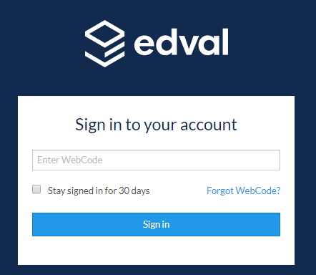
2. Click on the link and enter the personalised web-code.

Slide 27
3. Choose the Stage 5 Elective 2024 option. Students may need to log out if they have recently completed Sports Selections.

Slide 28
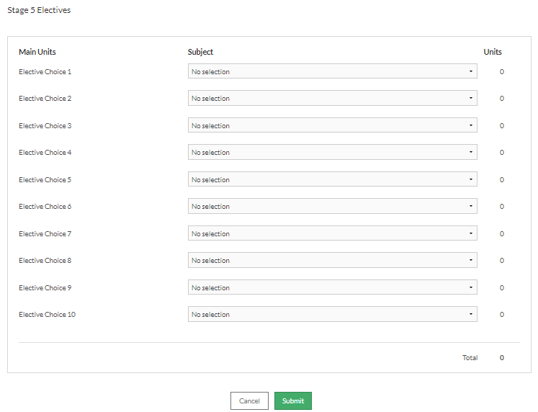
4. You will then be on a screen where you choose 10 electives for 2024. Place your choices in preference order.

Slide 29
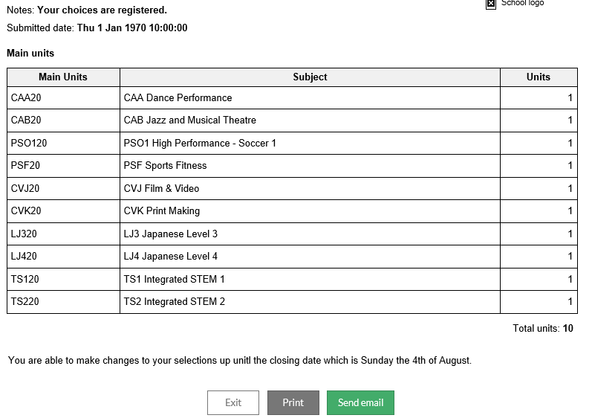
5. Press submit and either print or make a note of the electives that have chosen.

Slide 30
Important dates:
Online selections open – Tuesday 13 June at 4pm
Online selections close – Sunday 13 August at 10pm
Where to get more information:
Stage 5 Head Teacher – Mr Gary Monahan
gary.monahan@det.nsw.edu.au
Year Advisors – Mrs Rowena Flowers & Ms Aparna Vishwanathan
rowena.marren@det.nsw.edu.au
aparna.vishwanathan2@det.nsw.edu.au
Careers Advisors – Ms Jennifer Truong & Mrs Francesca Arroyo
jennifer.truong6@det.nsw.edu.au
francesca.tenedora3@det.nsw.edu.au
KLA Head and Classroom Teachers

Slide 31
Suggestions
Plan your Year 9 and Year 10 Course Units before submitting your Year 9 selections.
Remember you do not need to get all 400 hours completed in Year 9 and hours carry over to Year 10.
However, if possible try and obtain at least 3 x 100 hour Curriculum Courses in Year 9. This allows greater flexibility for subject choices in Year 10.
Avoid picking 4 Course Units (200hrs) from the same Curriculum Course in Year 9. This will limit the ability to choose subject from that area in Year 10.

Slide 32
Questions
If you have any questions about NESA requirements, CTHS subjects or the selection process please ask them now or email gary.monahan@det.nsw.edu.au

